Slide 1
Kubernates (Configmaps, Secrets, Persistent Volume , Persistent Volume Claim ) & LAB

Slide 2
ConfigMaps :
A ConfigMap is an API object that lets you store configuration for other objects to use.
Unlike most Kubernetes objects that have a spec , a ConfigMap has data and binaryData fields.
These fields accept key-value pairs as their values

Slide 3
Secrets :
Secrets are intended to store credentials to other services that a container might need or to store any sensitive information.
secrets can be mounted into a pod as a volume to expose needed information or can be injected as environment variables
Using a Secret means that you don't need to include confidential data in your application code.
Because Secrets can be created independently of the Pods that use them, there is less risk of the Secret (and its data) being exposed during the workflow of creating, viewing, and editing Pods.

Slide 4
PersistentVolume (PV) :
A PersistentVolume (PV) is a piece of storage in the cluster that has been provisioned by an administrator or dynamically provisioned using Storage Classes
It is a resource in the cluster just like a node is a cluster resource.
PVs are volume plugins like Volumes, but have a lifecycle independent of any individual Pod that uses the PV.

Slide 5
PersistentVolumeClaim (PVC) :
A PersistentVolumeClaim (PVC) is a request for storage by a user. It is similar to a Pod.
Pods consume node resources and PVCs consume PV resources. Pods can request specific levels of resources (CPU and Memory).
Claims can request specific size and access modes (e.g., they can be mounted ReadWriteOnce, ReadOnlyMany or ReadWriteMany, see AccessModes

Slide 6
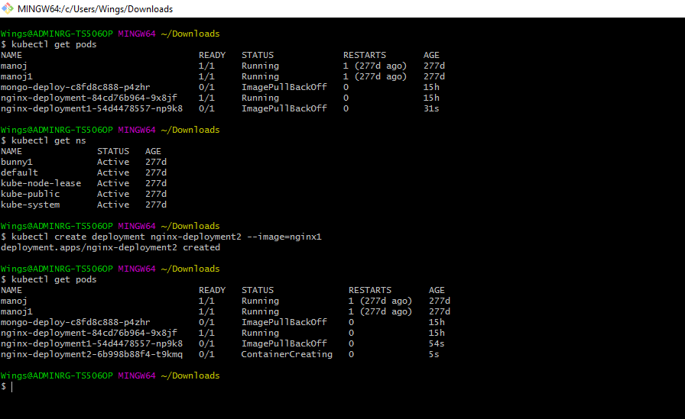

Slide 7
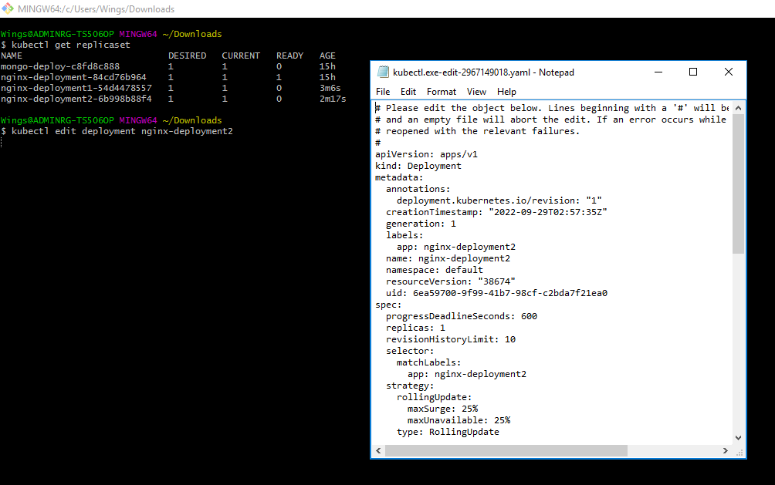

Slide 8
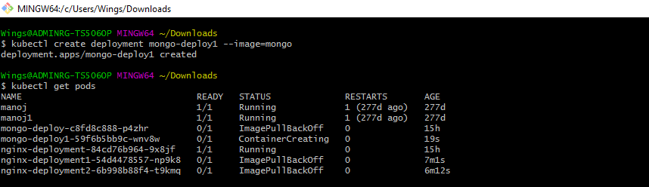

Slide 9
LAB-2 Deploy an application using mongoDB along with mongo-express

Slide 10
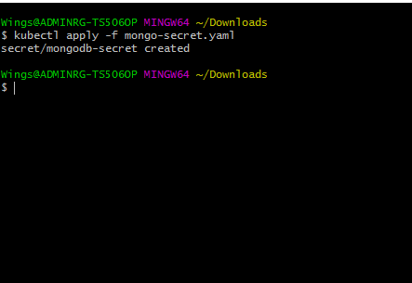
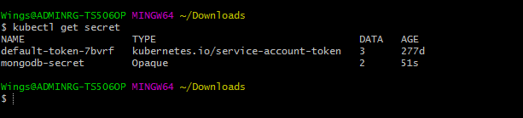

Slide 11
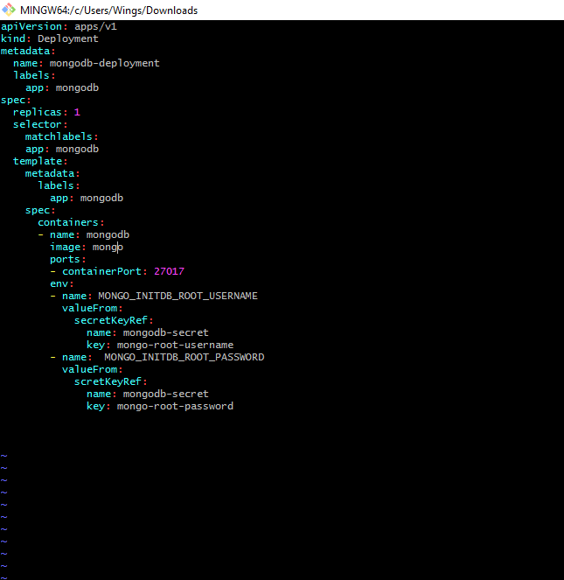

Slide 12
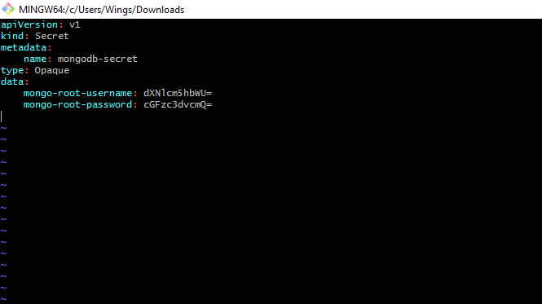

Slide 13
